Slide 1
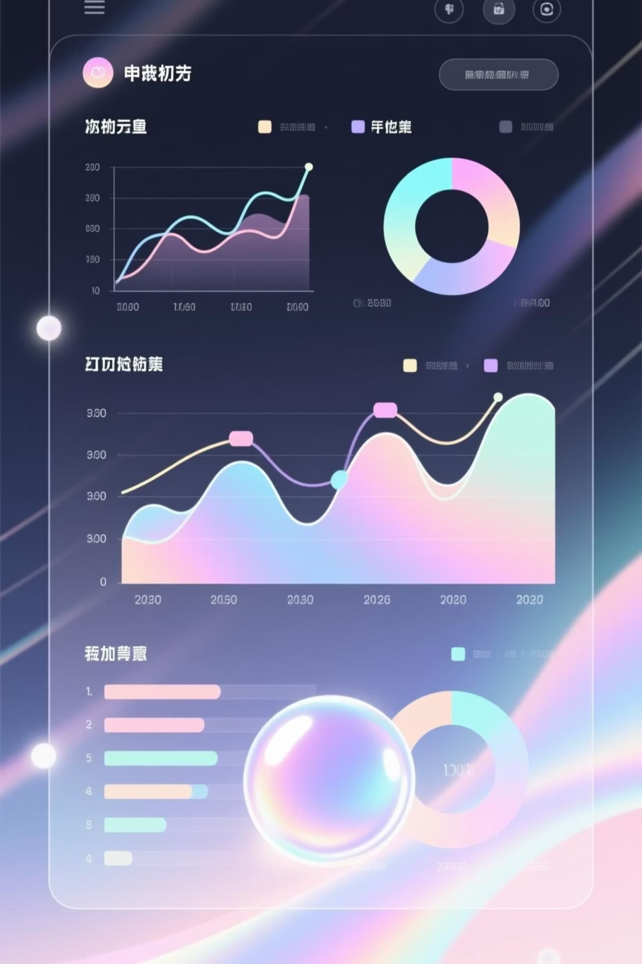
Customer Shopping Behavior Analysis
Uncovering insights from 3,900 transactions to optimize retention, marketing, and pricing strategies

Slide 2
Dataset Overview
3,900
18
37
Total Transactions
Key Features
Missing Values
Customer purchases analyzed
Demographics, purchases, behavior
Review Rating column only
Customer Demographics
Shopping Behavior
Age, Gender, Location
Discount & Promo Usage
Subscription Status
Purchase Frequency
Review Ratings

Slide 3

Data Preparation & Cleaning
01
02
Data Loading
Missing Data Handling
Imported dataset using pandas, explored structure with df.info() and .describe()
Imputed Review Rating nulls using median rating per product category
03
04
Feature Engineering
Database Integration
Created age_group bins and purchase_frequency_days columns
Connected to PostgreSQL and loaded cleaned data for SQL analysis

Slide 4
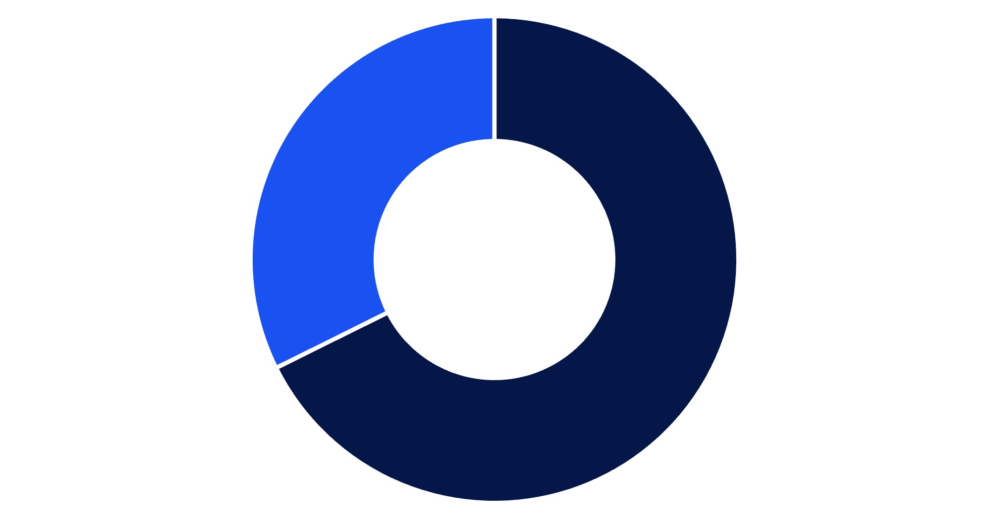
Revenue Analysis by Gender
Key Insight
Male customers generate 2.1x more revenue than female customers
Total revenue: $233,081
Male
Female

Slide 5


High-Value Discount Users
839
21.5%
Smart Shoppers
Customer Share
Customers using discounts while spending above average
Portion of total customer base
These customers demonstrate price sensitivity without sacrificing purchase value—ideal targets for loyalty programs

Slide 6
Top-Rated Products
96.5%
96.0%
95.5%
Gloves
Sandals
Boots
Highest rated: 3.86/5.0
Second place: 3.84/5.0
Third place: 3.82/5.0
95.0%
94.5%
Hat
Skirt
Fourth place: 3.80/5.0
Fifth place: 3.78/5.0

Slide 7
Shipping & Subscription Insights
Shipping Type Comparison
Subscription Status
Standard
1,053
2,847
Avg: $58.46
Subscribers
Non-Subscribers
$59.49 avg spend
$59.87 avg spend
Express
Similar spending patterns across both groups
Avg: $60.48
Express users spend 3.5% more per transaction

Slide 8



Customer Segmentation
Loyal Customers
1
3,116 customers (79.9%)
Returning Customers
2
701 customers (18.0%)
New Customers
3
83 customers (2.1%)
Strong loyal base presents opportunity to convert returning segment through targeted retention programs

Slide 9
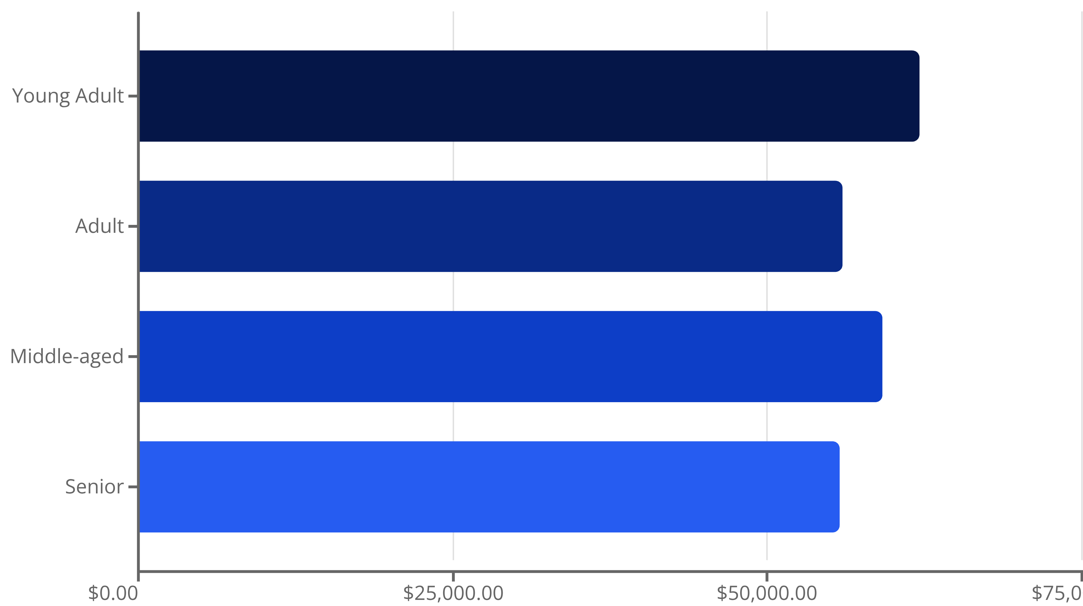
Revenue by Age Group
Young Adults drive highest revenue at $62,143—prime target for marketing campaigns

Slide 10

Strategic Recommendations
Boost Subscriptions
Loyalty Programs
Optimize Discounts
Promote exclusive benefits to increase subscriber base
Reward repeat buyers to move them into loyal segment
Balance sales boosts with margin control
Product Positioning
Targeted Marketing
Highlight top-rated items in marketing campaigns
Focus on Young Adults and express-shipping users

